Slide 1
COMP90054 AI Planning for Autonomy Workshop Week 10
Ruixi
huor@student.unimelb.edu.au

Slide 2
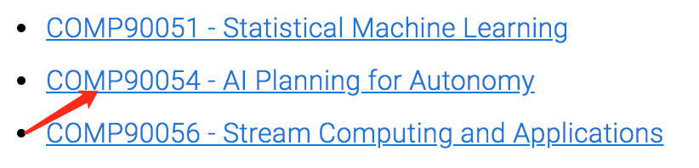
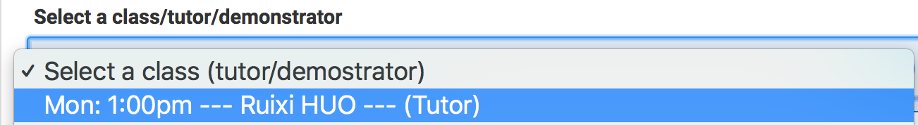
Fill in the survey
https://apps.eng.unimelb.edu.au/casmas/index.php?r=qoct/subjects

Slide 3
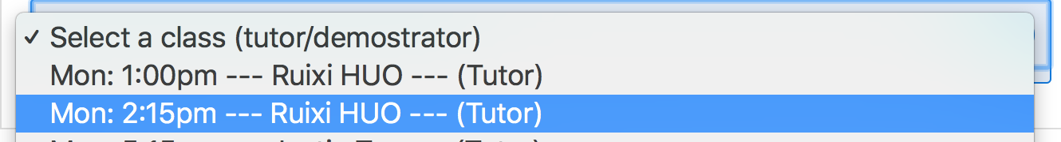
Fill in the survey
https://apps.eng.unimelb.edu.au/casmas/index.php?r=qoct/subjects

Slide 4
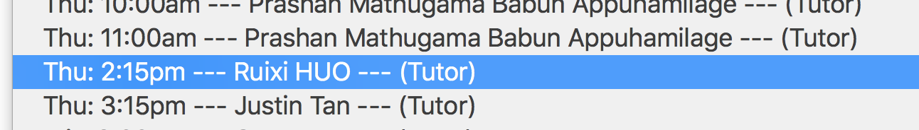
Fill in the survey
https://apps.eng.unimelb.edu.au/casmas/index.php?r=qoct/subjects

Slide 5
Objectives
Reinforcement Learning (Temporal Difference (TD) )
1. Q-Learning
1-step Q-Learning
n-step Q-Learning TD(n)
2. SARSA
1-step SARSA
n-step SARSA TD(n)

Slide 6
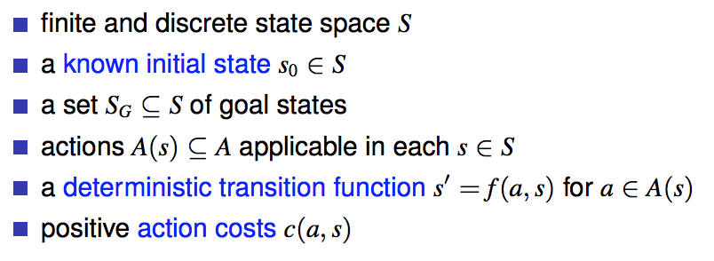
Comparison
Classical Planning
Value Iteration/Policy Iteration
Assume that each action could have multiple outcomes, with each outcome associated with a probability.
Reinforcement Learning
When we apply an action:
BUT
we don’t know the what probability of each outcome will be
we don’t know what reward we are going to get
(we know what actions can we apply)
Learn

Slide 7
Reinforcement Learning
Idea
Try things out, and then see what works, to reinforce your behavior
training a dog

Slide 8
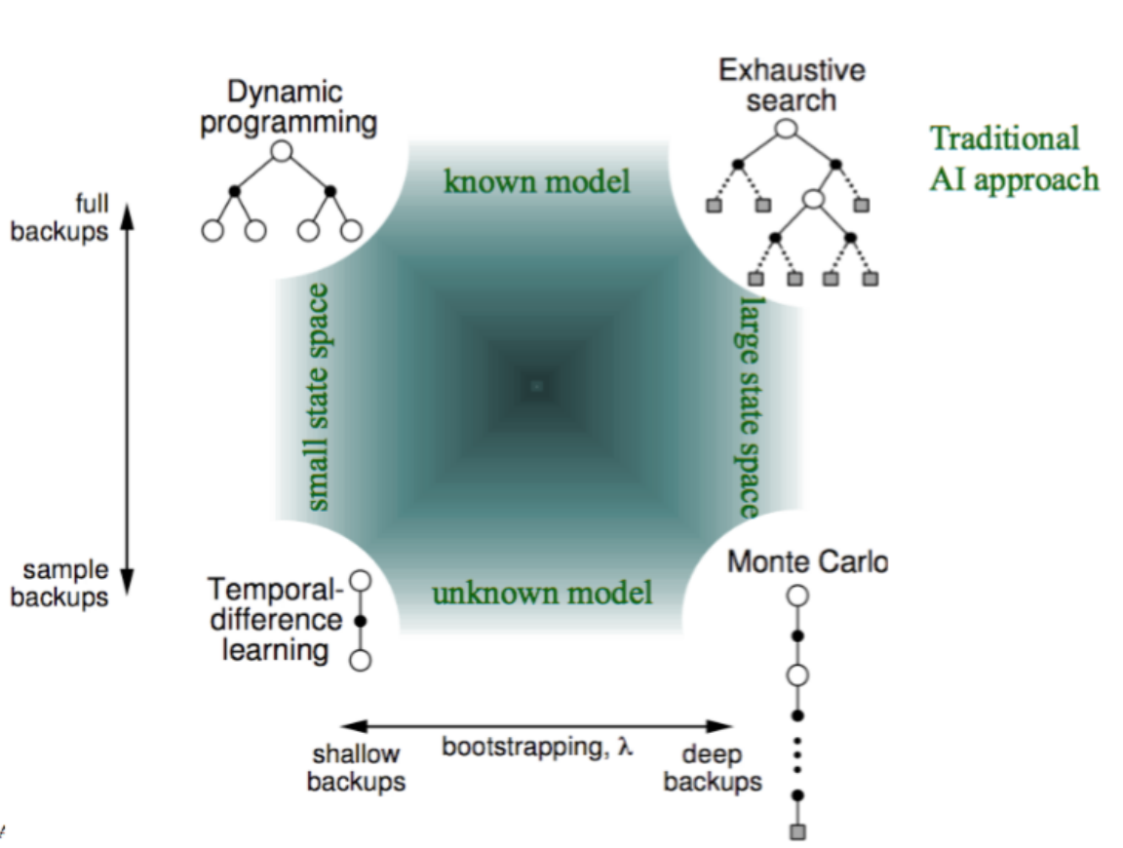
Application
Value Iteration
Policy Iteration
A*, WA*, Greedy Best First Search,
BFS, DFS
Reinforcement Learning
Monte Carlo Tree Search

Slide 9
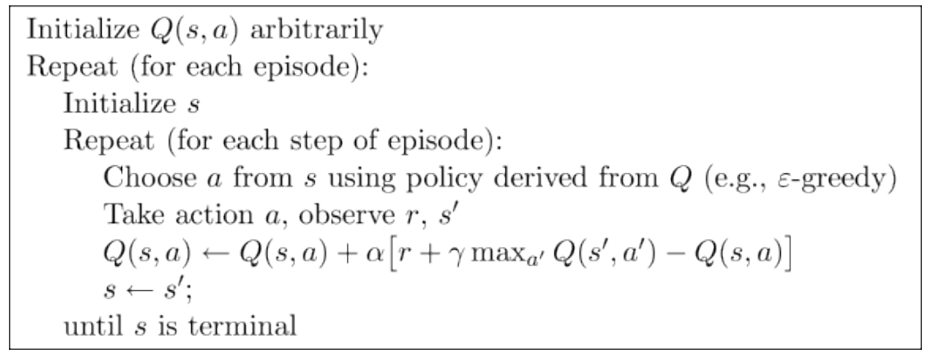
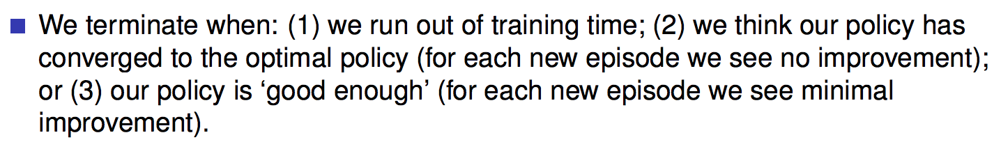
Q-Learning
trial
go to initial state
action selection using policy
execute action a and observe the reward r and new state s’
update Q-value
until we reach a terminate state or run out of time,
Then we start next episode
How many episodes do we need?

Slide 10
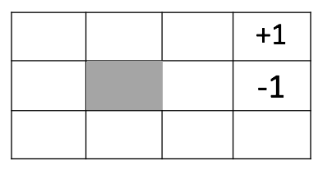
Q-Learning
Episode 1
Action Selection: Choose action a from state s using policy, e.g. $ε−greedy$
A B C
Execute action a and observe the reward r and new state s’
E G
Update Q(s, a) based on the r and s’
s
s’
H I J K
old value
recent value
old value
Q(I, right)
learning rate
discounted future reward
immediate reward

Slide 11
Q-Learning
Episode 1
Action Selection: Choose action a from state s using policy, e.g. $ε−greedy$
A B C
Execute action a and observe the reward r and new state s’
E G
Update Q(s, a) based on the r and s’
H I J K
old value
recent value
old value
Q(J, up)
learning rate
discounted future reward
immediate reward

Slide 12
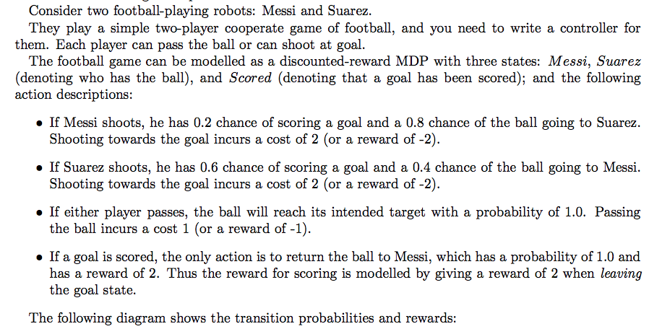
Scored
Return
r = 2
Shoot
r = -2
Shoot
r = -2
Shoot
r = -2
Note: As this is a reinforcement learning problem, assume that the transition probabilities are not accessible to your algorithm.
Messi
Suarez
Pass
r = -1
Shoot
r = -2

Slide 13
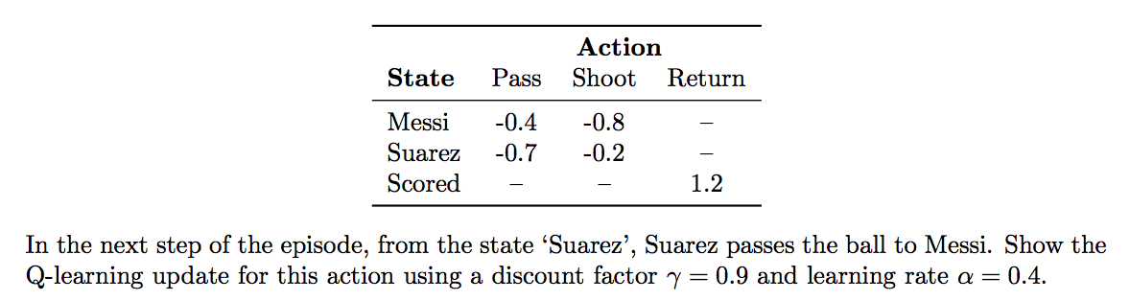
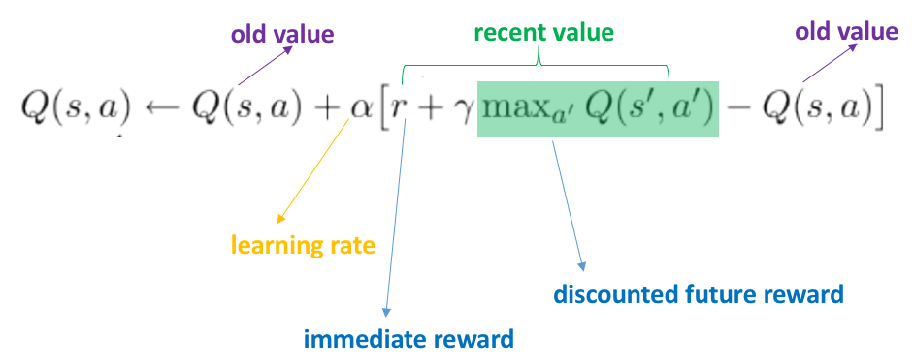
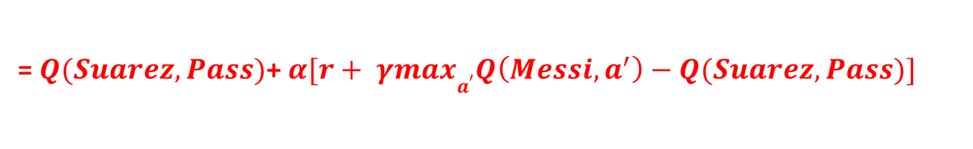
s
a
s’
The reward r of Suarez Pass is -1
Update Q(s,a)
Q(Suarez, Pass)
= $Q(Suarez,Pass)$+ $α[r+ γmaxa^{′}Q\left(Messi,a^{′}\right)−Q(Suarez,Pass)]$
-0.7
0.4
-1
0.9
-0.4
-0.7
= −0.964
Notes:
Q-table: to represent Q-value(s,a) each pair

Slide 14
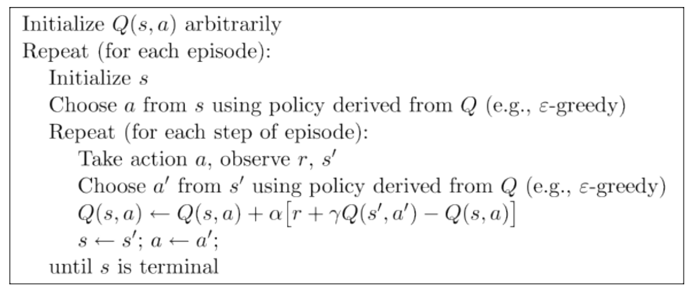
SARSA = State-action-reward-state-action
action selection using policy
SARSA uses the actual next action a’
to update Q(s,a)
update Q-value
On-Policy: Use the action chosen by the policy for the update

Slide 15
Q-Learning
action selection using policy
update Q-value
During update Q-value
Q-learning estimating Q(s’, a’ ) for the best estimated future state
Off-Policy: During update Q-value, ignore the action chosen by the policy, uses the best action argmax_{a’} Q(s’ , a’ ) for the update!
Notes:
We have several episodes, each episode will start from initial state s.

Slide 16
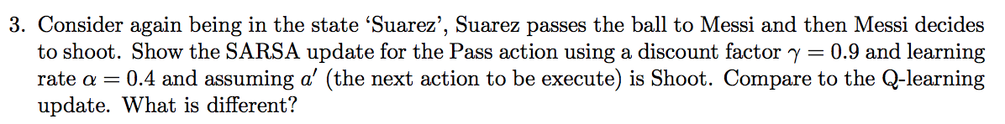
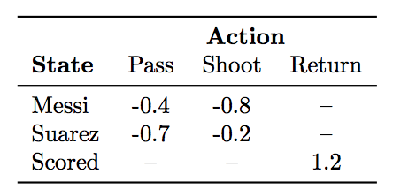
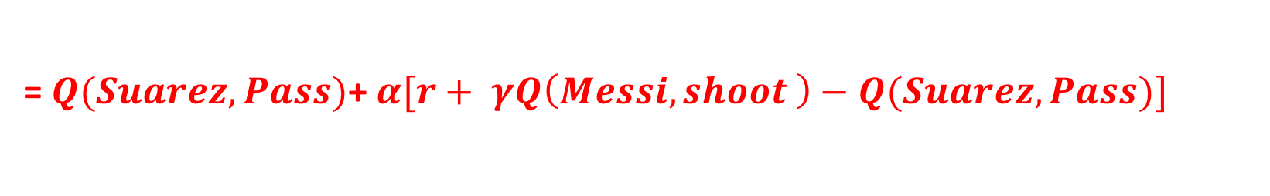
SARSA
s
a
s’
a’
Update Q(s,a)
Q(Suarez, Pass)
= $Q(Suarez,Pass)$+ $α[r+ γQ\left(Messi, shoot \right)−Q(Suarez,Pass)]$
-0.7
0.4
-1
0.9
-0.8
-0.7
= −1.108

Slide 17
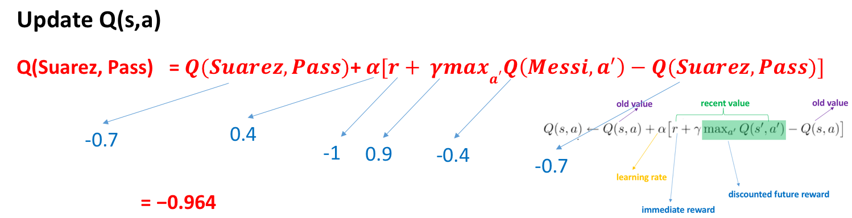
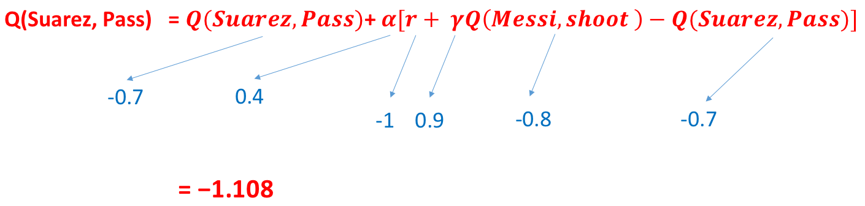
Q-Learning
optimistic
SARSA

Slide 18
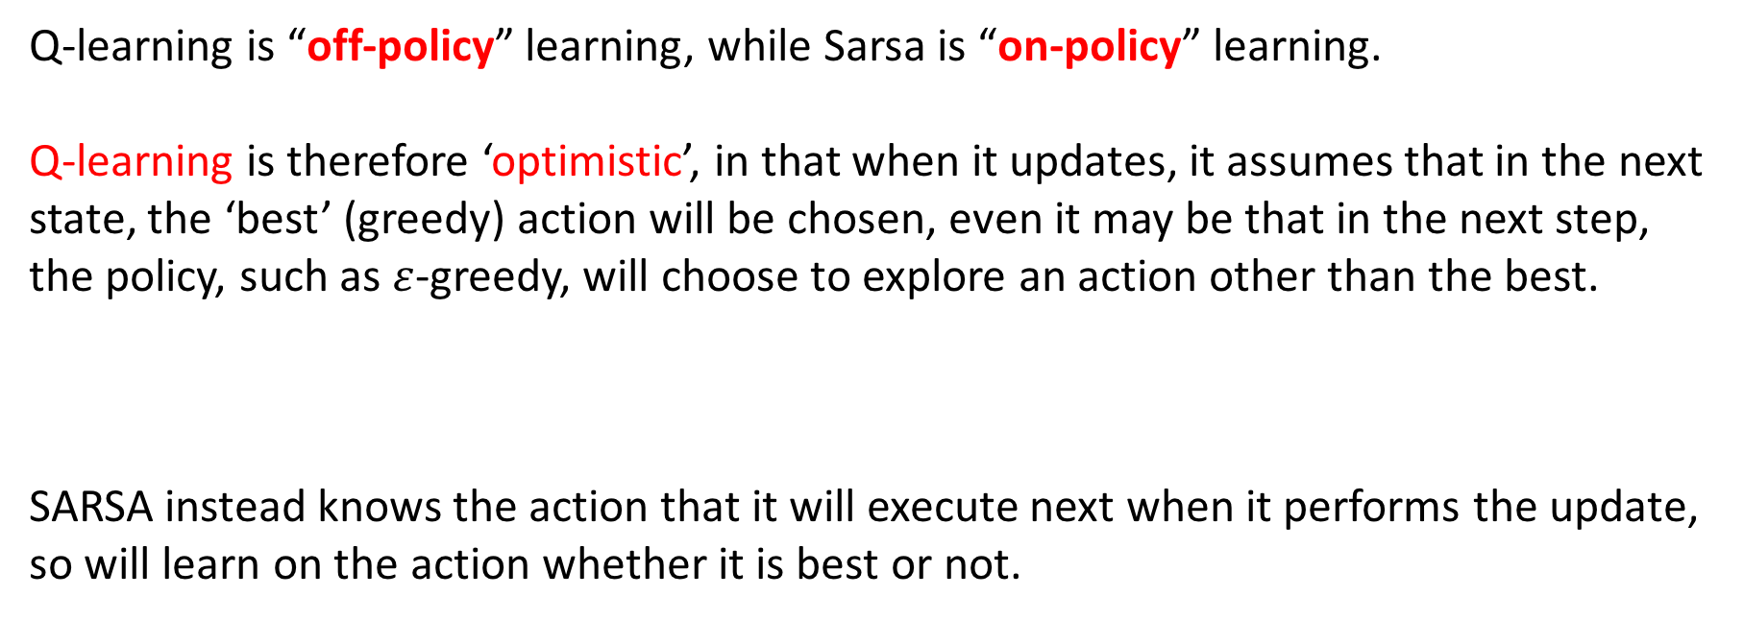
The difference between SARSA and Q-learning
Q-learning is “off-policy” learning, while Sarsa is “on-policy” learning.
Q-learning is therefore ‘optimistic’, in that when it updates, it assumes that in the next state, the ‘best’ (greedy) action will be chosen, even it may be that in the next step, the policy, such as $ε$-greedy, will choose to explore an action other than the best.
SARSA instead knows the action that it will execute next when it performs the update, so will learn on the action whether it is best or not.
unsafe or risky
safe

Slide 19
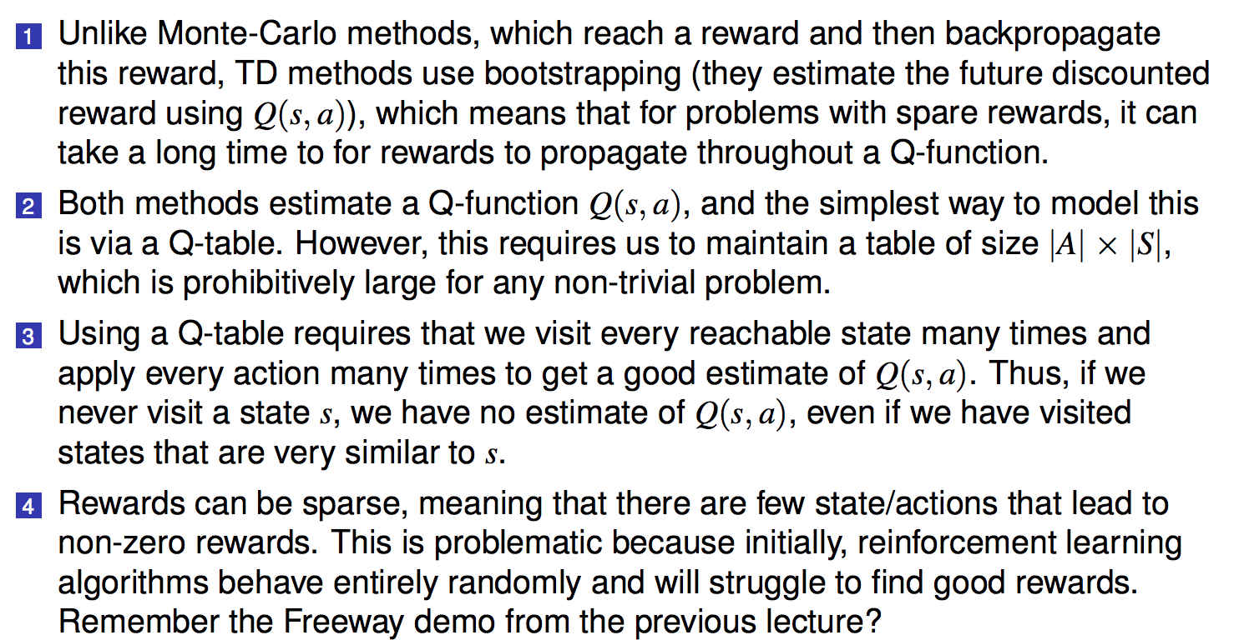
Some Weaknesses of Q-learning and SARSA
A B C
E G
H I J K
N-step Q-learning or N-step SARSA
Q(K,up)
Notes:
When we play an action, we only get the feedback of the action we just played at a certain state, but no other states.
It didn’t provide any feedback for other states.

Slide 20
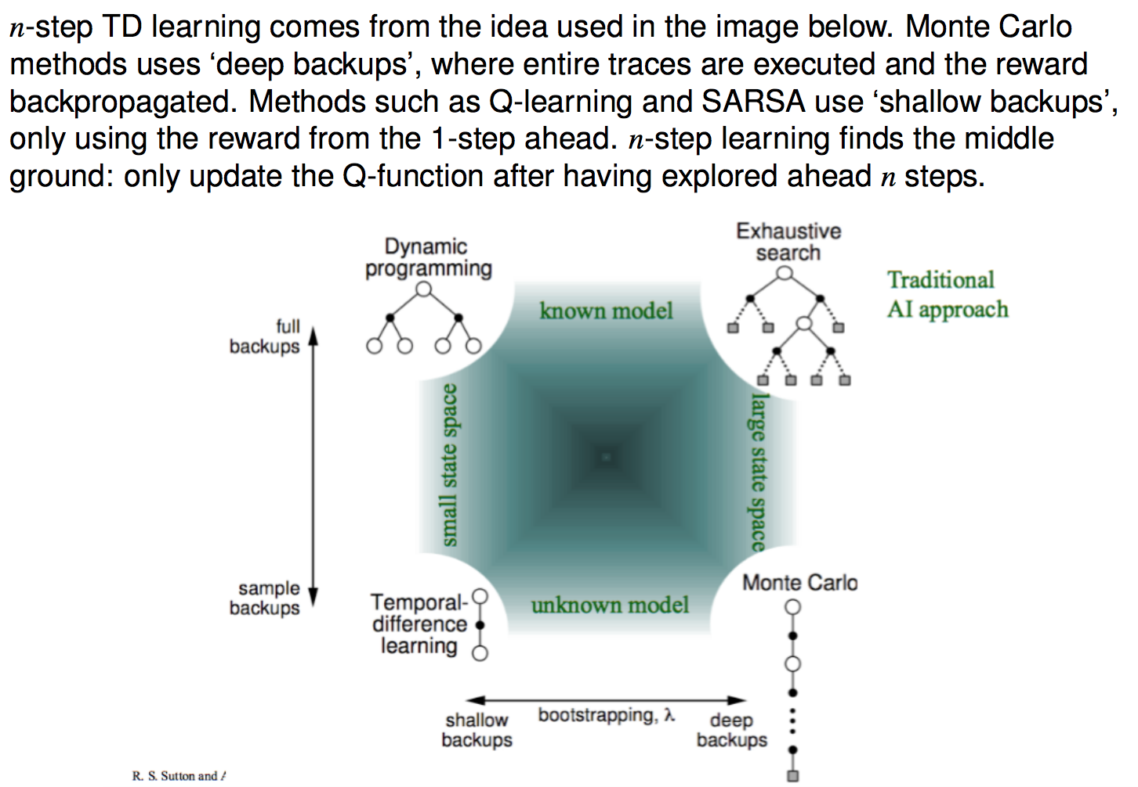

Slide 21
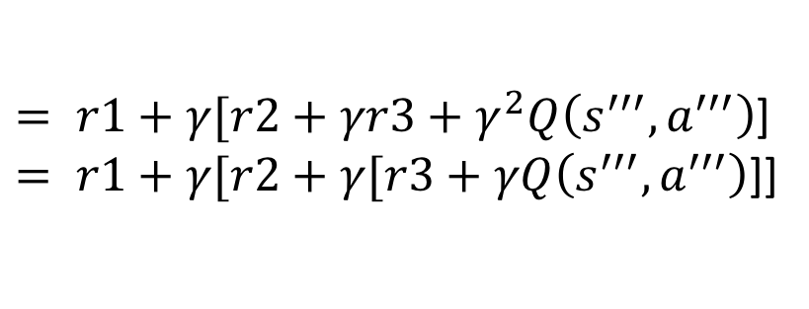
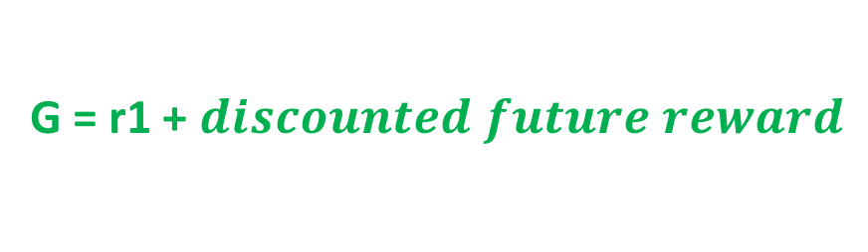
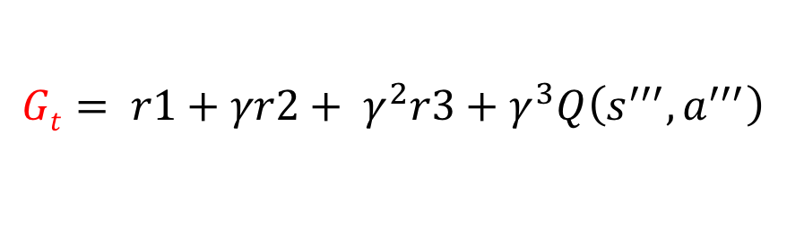
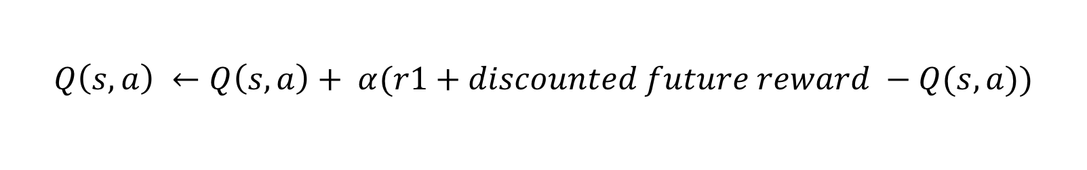
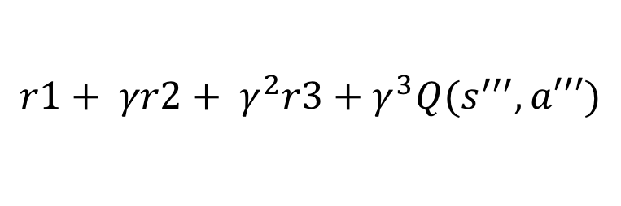
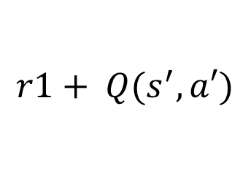

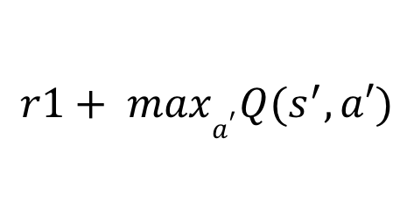

Update Q-value
$$Q\left(s, a\right) ←Q\left(s, a\right)+ α(r1+discounted future reward −Q(s, a))$$
G = r1 + $discounted future reward$
Q-learning:
$$r1+ maxa^{′}Q(s^{′}, a′)$$
1-step SARSA
$$r1+ Q(s^{′}, a′)$$
2-step SARSA
$$r1+γr2+γ^{2}Q\left(s^{′′}, a^{′′}\right)$$
3-step SARSA
$$r1+ γr2+ γ^{2}r3+γ^{3}Q(s^{′′′}, a′′′)$$
$$Gt= r1+γr2+ γ^{2}r3+γ^{3}Q\left(s^{′′′}, a^{′′′}\right)$$
$= r1+γ[r2+γr3+γ^{2}Q\left(s^{′′′}, a^{′′′}\right)$]
$= r1+γ[r2+γ[r3+γQ\left(s^{′′′}, a^{′′′}\right)$]]
If Gt is the value received at time-step t,
then Gt = rt + γGt+1
$$Q\left(s, a\right) ←Q\left(s, a\right)+ α(Gt−Q(s, a))$$

Slide 22
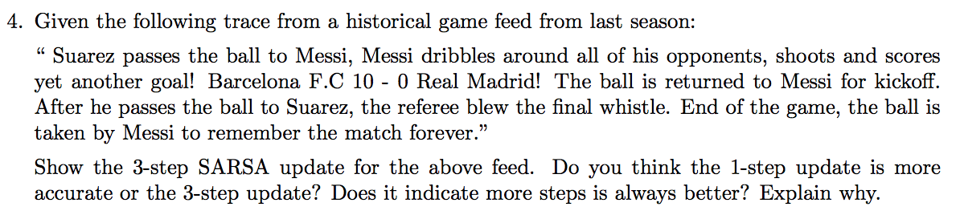
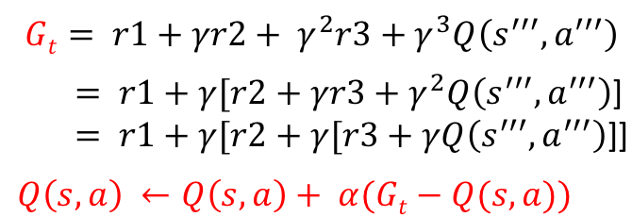
3-step SARSA
s
a
s’
a’
s’’
a’’
a’’’
s’’’
Scored
(3)Return
r = 2
(2)Shoot
r = -2
Messi
(1)Pass
r = -1
Suarez
(action selection for update)
Pass
r = -1

Slide 23
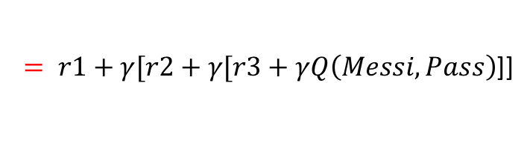
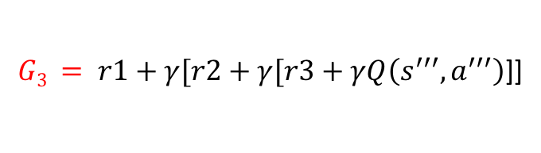
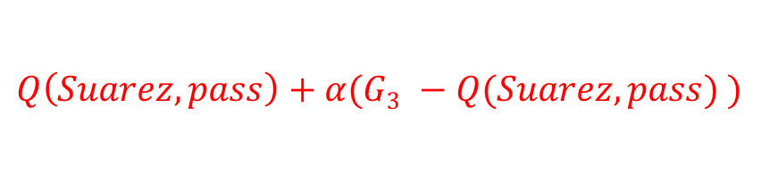
3-step SARSA
s
a
s’
a’
s’’
a’’
a’’’
s’’’
Update Q(s, a)
Q(Suarez, pass) =
$$Q\left(Suarez, pass\right)+α(G3 −Q(Suarez, pass) )$$
$$G3 = r1+γ[r2+γ[r3+γQ\left(s^{′′′}, a^{′′′}\right)\text{]]}$$
$= r1+γ[r2+γ[r3+γQ\left(Messi, Pass\right)\text{]]}$
Pass -1
Shoot
-2
Return
2
-0.4
Q(Suarez, pass) = −1.00864

Slide 24
1-step SARSA
VS 3-step SARSA
Basically 3-step SARSA is more accurate than 1-step SARSA,
it can converge much faster than 1-step.

Slide 25
